Slide 1
Sistem Pakar (Rule Based Reasoning)

Slide 2
What is Expert System?
An expert system:
an interactive computer-based decision tool
uses both facts and heuristics to solve difficult decision making problems (non-algorithmic expertise)
based on knowledge acquired from an expert.
An expert system compared with traditional computer :
Expert system = inference engine + knowledge
Program in traditional computer = algorithm + data structures
First expert system, called DENDRAL, was developed in the early 70's at Stanford University.
Untuk identifikasi struktur molekul campuran yang tidak dikenal

Slide 3
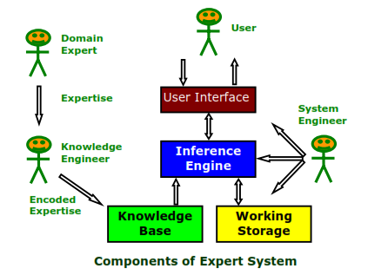
Expert System Components
Knowledge base : A declarative representation of the expertise; often in IF THEN rules ;
Working storage : The data which is specific to a problem being solved;
Inference engine : The code at the core of the system which derives recommendations from the knowledge base and problemspecific data in working storage;
User interface : The code that controls the dialog between the user and the system.

Slide 4
Expert System Components (cont.)
Domain expert : The individuals who currently are experts in solving the problems; here the system is intended to solve;
Knowledge engineer : The individual who encodes the expert's knowledge in a declarative form that can be used by the expert system;
User : The individual who will be consulting with the system to get advice which would have been provided by the expert.

Slide 5
Expert System Characteristics
Operates as an interactive system
Responds to questions
Asks for clarifications
Makes recommendations
Aids the decision-making process.
Tools have ability to sift (filter) knowledge
Storage and retrieval of knowledge
Mechanisms to expand and update knowledge base on a continuing basis.

Slide 6
Expert System Characteristics (cont.)
Make logical inferences based on knowledge stored
Simple reasoning mechanisms is used
Knowledge base must have means of exploiting the knowledge stored, else it is useless;
e.g., learning all the words in a language, without knowing how to combine those words to form a meaningful sentence.
Domain-Specific
A particular system caters a narrow area of specialization; e.g., a medical expert system cannot be used to find faults in an electrical circuit.
Quality of advice offered by an expert system is dependent on the amount of knowledge stored.

Slide 7
Expert System Characteristics (cont.)
Capability to assign Confidence Values
Can deliver quantitative information
Can address imprecise and incomplete data through assignment of confidence values.
Applications
Best suited for those dealing with expert heuristics for solving problems.
Not a suitable choice for those problems that can be solved using purely numerical techniques.
Cost-Effective alternative to Human Expert
Specialists in many areas are rare and the cost of consulting them is high; an expert system of those areas can be useful and cost-effective alternative in the long run.

Slide 8
Kekurangan Sistem Pakar
Biaya yang cukup mahal untuk pengembangan dan pemeliharaannya.
Kadang kala pengembangan mengalami kesulitan →
karena keterbatasan keahlian dan ketersediaan pakar
Kesulitan dalam proses akuisisi pengetahuan pakar
Sistem pakar belum tentu 100% benar.
Transferring knowledge from the human expert to a computer is often the most difficult part of building an expert system.

Slide 9
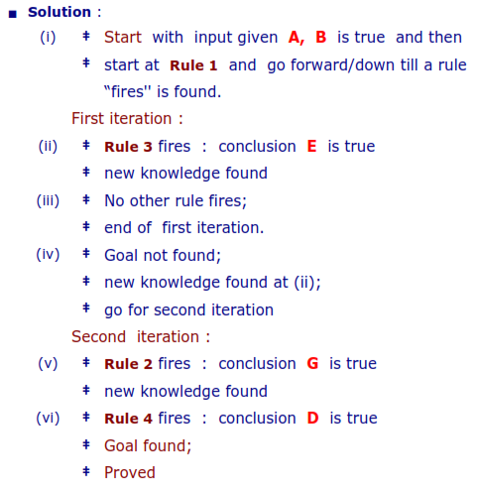
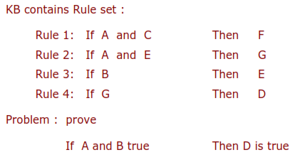
Expert System Features
Data Driven Reasoning or Forward Chaining
An inference technique which uses IF-THEN rules to deduce a problem solution from initial data;

Slide 10
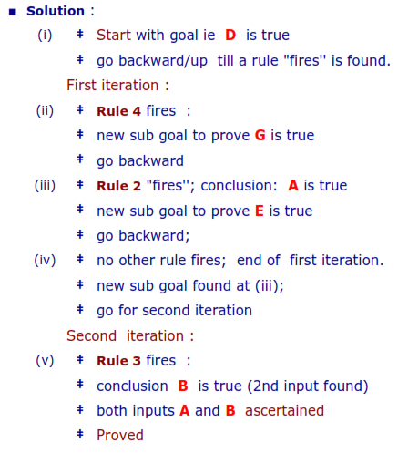
Expert System Features (cont.)
Goal Driven Reasoning or Backward Chaining
An inference technique which uses IF-THEN rules to repetitively break a goal into smaller sub-goals which are easier to prove;

Slide 11
Expert System Features (cont.)
Coping with Uncertainty
Often the Knowledge is imperfect which causes uncertainty.
To work in the real world, Expert systems must be able to deal with uncertainty.
One simple way is to associate a numeric value with each piece of information in the system (which represents the certainty of the information).
Data Representation
Expert system is built around a knowledge base module.
Knowledge acquisition is transferring knowledge from human expert to computer.
Knowledge representation is faithful representation of what the expert knows.
The success of expert system depends on choosing knowledge encoding scheme best for the kind of knowledge the system is based on.

Slide 12
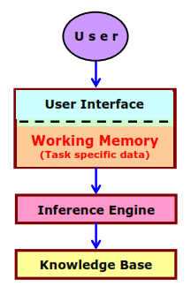
Expert System Features (cont.)
User Interface
That portion of the code which creates an easy to use system;
The acceptability of an expert system depends largely on the quality of the user interface.
User interface is also closely related to working memory.
Working memory refers to task-specific data for a problem.
Data specific to the problem needs to be input by the user at the time of using, means consulting the expert system.
Therefore, the contents of the working memory, changes with each problem situation.

Slide 13
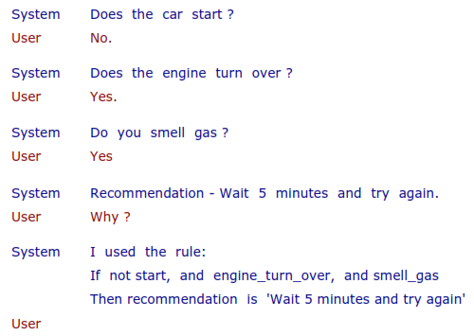
Expert System Features (cont.)
Explanations
The ability of the system to explain the reasoning process that it used to reach a recommendation.
They allow the user to ask questions - why and how it reached some conclusion.
They also allow the knowledge engineer to see how the system is behaving, and how the rules and data are interacting.

Slide 14
Ketidakpastian (Uncertainty) Sistem Pakar Berbasis Rule
Ketidakpastian data
Data/informasi yang diapat tidak lengkap
Didapat dari sumber yang kurang dipercaya
Berasal dari berbagai sumber yang saling bertolak belakang
Ketidakpastian dalam proses inferensi (rule)
Rule mewakili pengamatan pakar
Rule didesain secara general untuk semua orang, bisa jadi tidak sesuai untuk orang tertentu.

Slide 15
Beberapa Cara Menangani Uncertainty
Probababilitas
Certainty Factor (CF)

Slide 16
Certainty Factor
Diusulkan oleh Shortliffe dan Buchanan pada tahun 1975
Mengakomodasi ketidakpastian pemikiran (inexact reasoning) seorang pakar, misalnya seorang pakar sering kali menganalisis informasi dengan ungkapan "kemungkinan besar", "mungkin", "hampir pasti".
Cara mendapatkan tingkat keyakinan (CF) dari sebuah rule:
Metode Net Belief
Metode Wawancara

Slide 17
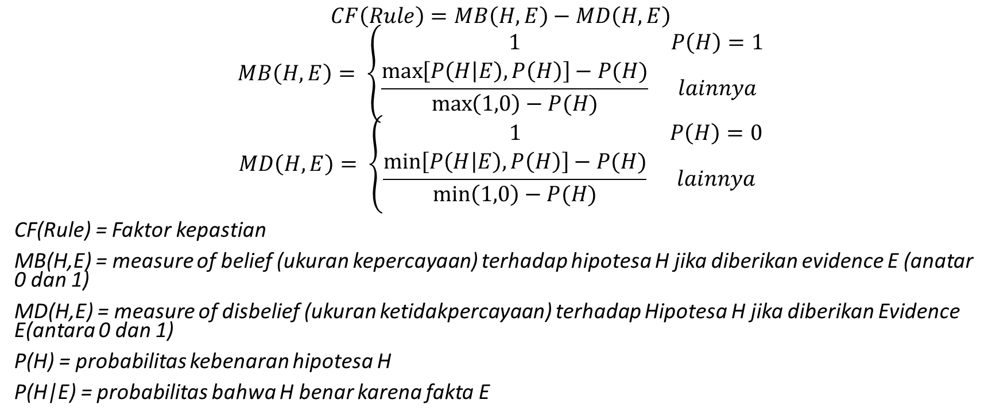
Metode Net Belief
$$CF\left(Rule\right)=MB\left(H,E\right)−MD\left(H,E\right)$$
$$MB\left(H,E\right)= \left\{\begin{matrix}1 & P\left(H\right)=1 \\ \frac{\max\left[P\left(H | E\right),P\left(H\right)\right]−P(H)}{\max\left(1,0\right)−P(H)} & lainnya\end{matrix}\right.$$
$$MD\left(H,E\right)= \left\{\begin{matrix}1 & P\left(H\right)=0 \\ \frac{\min\left[P\left(H | E\right),P\left(H\right)\right]−P(H)}{\min\left(1,0\right)−P(H)} & lainnya\end{matrix}\right.$$
CF(Rule) = Faktorkepastian
MB(H,E) = measure of belief (ukurankepercayaan) terhadaphipotesa H jikadiberikan evidence E (anatar 0 dan 1)
MD(H,E) = measure of disbelief (ukuranketidakpercayaan) terhadapHipotesa H jikadiberikan Evidence E(antara 0 dan 1)
P(H) = probabilitaskebenaranhipotesa H
P(H|E) = probabilitasbahwa H benarkarenafakta E

Slide 18
Metode Net Belief (cont.)
Contoh:
Seorang pakar penyakit kelamin menyatakan bahwa probabilitas seseorang berpenyakit phimosis adalah 0,02. Data lapangan menunjukkan bahwa dari 100 orang mengalami gejala kulup berminyak, 40 orang positif terkena penyakit phimosis. Hitung factor kepastian bahwa phimosis disebabkan oleh adanya kulup berminyak.
Asumsi:
H : hipotesa terjadinya penyakit phimosis
E: evidence gejala kulup berminyak

Slide 19
Metode Wawancara
Dengan cara mewawancarai seorang pakar
Uncertain Term | CF
Definetely not (pasti tidak) | -1,0
Almost certainly not (hampir pasti tidak) | -0,8
Probably not (kemungkinan besar tidak) | -0,6
Maybe not (mungkin tidak) | -0,4
Unknown (tidak tahu) | -0,2 – 0,2
Maybe (mungkin) | 0,4
Probably (kemungkinan besar) | 0,6
Almost certainly (hampir pasti) | 0,8
Definitely (pasti) | 1,0

Slide 20
Metode Wawancara (cont.)
Contoh:
Pakar: Jika batuk dan panas, maka hampir dipastikan (almost certainly) penyakitnya adalah influenza.
Rule: IF (batuk AND panas) THEN penyakit = influenza (CF = 0,8)

Slide 21
Perhitungan Certainty Factor Gabungan
IF E₁ AND E₂ AND … E_{N} THEN H (CF Rule)
atau
IF E₁ OR E₂ OR … E_{N} THEN H (CF Rule)
Keterangan:
E₁ … E_{N} : fakta-fakta (evidence) yang ada
H : Hipotesis atau konklusi yang dihasilkan
CF Rule : tingkat keyakinan terjadinya hipotesis H akibat adanya fakta-fakta E₁ … E_{N}

Slide 22
Perhitungan Certainty Factor Gabungan
Rule dengan evidence E tunggal dan hipotesis H tunggal.
Rule dengan evidence E ganda dan hipotesis H tunggal.
Kombinasi dua buah rule dengan evidence E berbeda, tetapi hipotesis H sama.

Slide 23
Rule dengan evidence E tunggal dan Hipotesis H tunggal
IF E THEN H (CF Rule)
CF(H,E) = CF(E) x CF(rule)
Catatan: Secara praktik, nilai CF rule ditentukan oleh pakar, sedangan nilai CF(E) ditentukan oleh pengguna saat berkinsultasi dengan sistem pakar.
Contoh:
IF hari ini terang THEN besok hujan (CF rule = 0,6)
CF(hari ini terang) = 0,4
CF(besok hujan, hari ini terang) = 0,4 x 0,6 = 0,24

Slide 24
Rule dengan evidence E ganda dan hipotesis H tunggal
IF E₁ AND E₂ AND … E_{N} THEN H (CF Rule)
CF(H,E) = min(CF(E₁), CF(E₂), …, CF(E_{N})] x CF(rule)
IF E₁ OR E₂ OR … E_{N} THEN H (CF Rule)
CF(H,E) = max(CF(E₁), CF(E₂), …, CF(E_{N})] x CF(rule)

Slide 25
Rule dengan evidence E ganda dan hipotesis H tunggal (cont.)
Contoh:
IF demam AND batuk AND muntah THEN penyakit = TBC (CF rule = 0,3)
CF(demam) = 0,4
CF(batuk) = 0,2
CF(muntah) = 0,7
CF(TBC, demam, batuk, muntah) = min(0,4 , 0,2 , 0,7) x 0,3 = 0,06

Slide 26
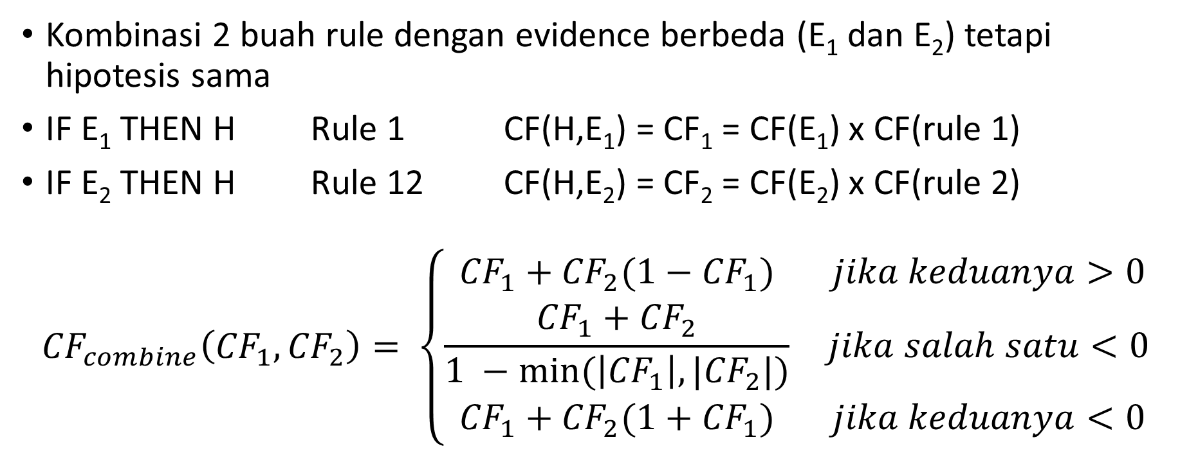
Kombinasi dua buah rule dengan evidence E berbeda, tetapi hipotesis H sama.
Kombinasi 2 buah rule dengan evidence berbeda (E₁danE₂) tetapihipotesissama
IF E₁ THEN H Rule 1 CF(H,E₁) = CF₁ = CF(E₁) x CF(rule 1)
IF E₂ THEN H Rule 12 CF(H,E₂) = CF₂ = CF(E₂) x CF(rule 2)
$${CF}_{combine}\left({CF}_{1},{CF}_{2}\right)= \left\{\begin{matrix}{CF}_{1}+{CF}_{2}(1−{CF}_{1}) & jika keduanya>0 \\ \frac{{CF}_{1}+{CF}_{2}}{1 −min⁡(\left|{CF}_{1}\right|,|{CF}_{2}|)} & jika salah satu<0 \\ {CF}_{1}+{CF}_{2}(1+{CF}_{1}) & jika keduanya<0\end{matrix}\right.$$

Slide 27
Kombinasi dua buah rule dengan evidence E berbeda, tetapi hipotesis H sama (cont.)
Contoh:
Rule 1: IF batuk THEN penyakit = batuk rejan (CF = 0,8)
Rule 2: IF demam THEN penyakit = batuk rejan (CF = 0,6)
Hitung CF gabungan jika:
CF(batuk) = 1 dan CF(demam) = 1
CF(batuk) = 1 dan CF(demam) = -1
CF(batuk) = -1 dan CF(demam) = -1

Slide 28
Contoh: Sistem Pakar Ramalan Cuaca
Rule | Isi Rule | CF (rule)
1 | IF hari ini hujan THEN besok hujan | 0,5
2 | IF hari ini terang THEN besok terang | 0,5
3 | IF hari ini hujan AND hujan gerimis THEN besok terang | 0,6
4 | IF hari ini hujan AND hujan gerimis AND suhu dingin THEN besok terang | 0,7
5 | IF hari ini terang AND suhu hangat THEN besok hujan | 0,65

Slide 29
Contoh: Sistem Pakar Ramalan Cuaca
Sistem pakar: Bagaimana cuaca hari ini?
Pengguna: Hujan, CF = 1
CF (hari ini hujan) = 1
Rule 1: IF hari ini hujan THEN besok hujan (CF = 0,5)
CF (besok hujan, hari ini hujan) = 1 x 0,5 = 0,5

Slide 30
Contoh: Sistem Pakar Ramalan Cuaca
Sistem pakar: Hujan deras atau gerimis?
Pengguna: gerimis (CF = 0,8)
CF (hujan gerimis) = 0,8
Rule 3: IF hari ini hujan AND hujan gerimis THEN besok terang (CF = 0,6)
CF (besok terang, hari ini hujan AND hujan gerimis) = min(1 , 0,8) x 0,6 = 0,48

Slide 31
Contoh: Sistem Pakar Ramalan Cuaca
Sistem pakar: Bagaimana suhu hari ini?
Pengguna: dingin (CF = 0,9)
CF (suhu dingin) = 0,9
Rule 4: IF hari ini hujan AND hujan gerimis AND suhu dingin THEN besok terang (CF = 0,7)
CF(besok terang, hari ini hujan AND hujan gerimis AND suhu dingin) = min (1, 0,8 , 0,9) x 0,7 = 0,56

Slide 32
Contoh: Sistem Pakar Ramalan Cuaca
Rule 3 dan Rule 4 mempunyai evidence yang berbeda, tetapi hipotesis sama
Dengan demikian, CF gabungan untuk CF dari rule 3 dan rule 4 adalah:
CF(besok terang) = CF₃ + CF₄ (1-CF₃)
= 0,48 + 0,56 (1 – 0,48)
= 0,77

Slide 33
Contoh: Sistem Pakar Ramalan Cuaca
Tidak ada rule yang dapat dibangkitkan lagi.
Dengan demikian:
CF (besok hujan) = 0,5
CF (besok terang) = 0,77
Kesimpulan sistem pakar: besok terang dengan tingkat kepercayaan 77%

Slide 34
TUGAS
Carilah sebuah artikel ilmiah dengan topik sistem pakar.
Berikan review dalam hal:
Domain/ kasus yang diangkat
Yang bertidak sebagai pakar
Bentuk representasi pengetahuan dan basis pengetahuan
Mekanisme inferensi yang digunakan Metode untuk menangani ketidakpastian (uncertainty)
Contoh inferensi untuk sebuah kasus
Kualitas/ ketersediaan fitur (user interface, fitur explanation, dll).

